Slide 1
“Green Sense”
- An Intelligent plant guard

Slide 2
What is “Green Sense” ?

Slide 3
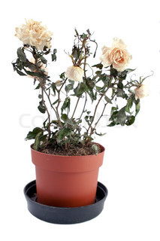
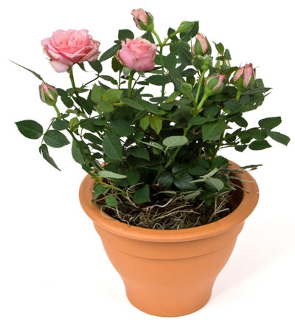



Where it started….
CARE

Slide 4
What is the Solution ?
- “Green Sense” comes for the rescue

Slide 5
“Green Sense”
It is an Arduino based System.
It will take care of your plants.
It will Monitor the Moisture in the Soil of your Plant and water them if it needs that.
Not only this, it will also monitor the Temperature, Humidity and Light around your Plants and alert you if there is Critical temperature or Humidity or Critical Light around the Plants.
It choose the Social network “Twitter” medium to send the notification.
By using Green Sense your favourite plants will always remain happy.

Slide 6
Day 0 of “Project Green Sense”
- “If you have an Idea just go and Make it” ~ Massimo Banzi (Arduino co-founder)

Slide 7
Portraying the Idea on Board
Getting the Idea is OK but implying it in real life Scenario is a bit difficult task.
Embedding the Idea
Collecting Hardware : It’s a little difficult task to collect the Hardware because collecting all the required Hardware on a go for such kind of imaginary project is not an easy task
Getting Hardware : Arduino Uno, Soil Moisture Sensor, Light Sensor(LDR), Temperature and Humidity Sensor(DHT11), Servo Motor, Ethernet Shield, LED Light, Relay, Water Pump
Writing Sketch for all of ‘em

Slide 8
Hardware
- “hardware becomes a piece of culture that anyone can build upon, like a poem or a song”
~ Massimo Banzi (Arduino co-founder)

Slide 9
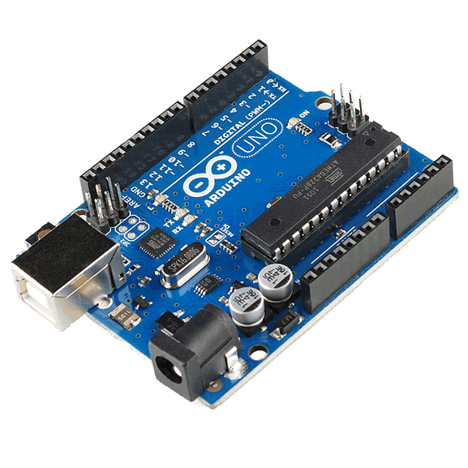
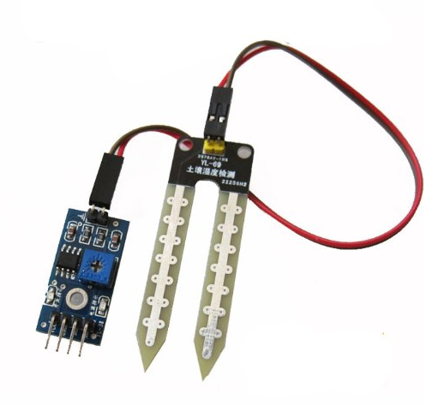
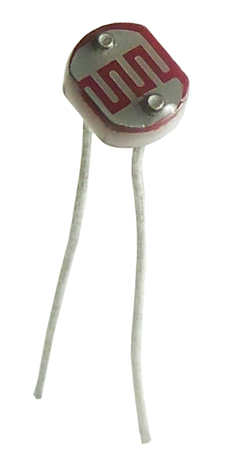
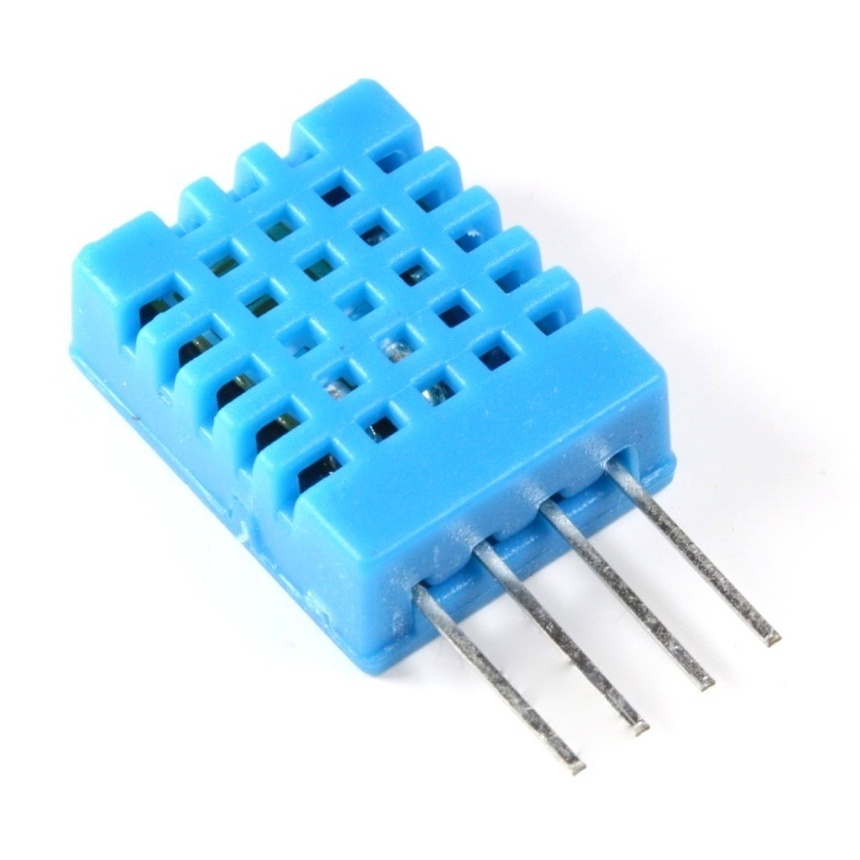
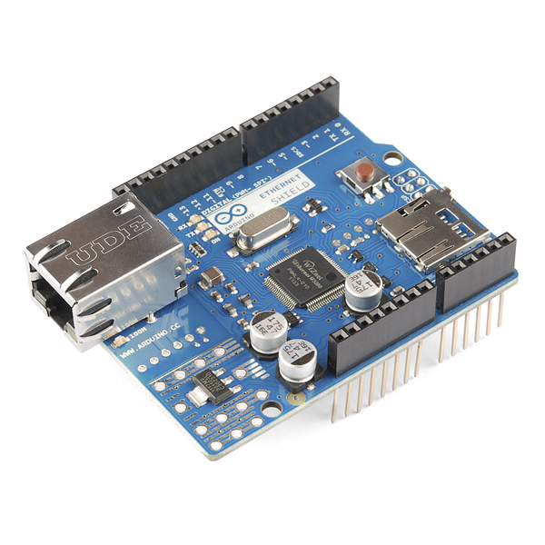
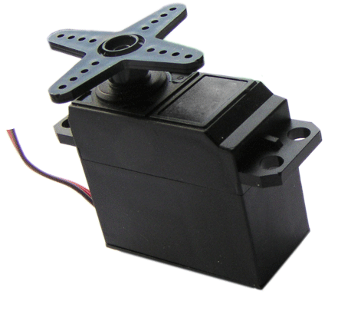
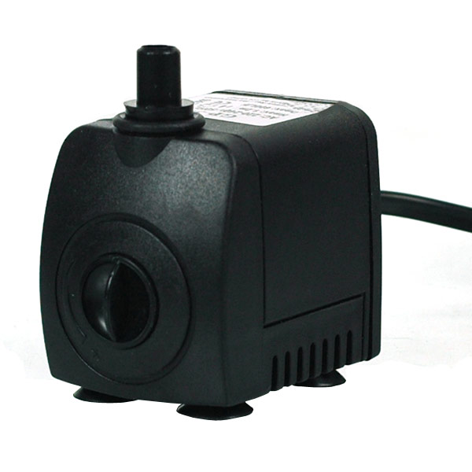
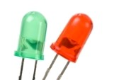
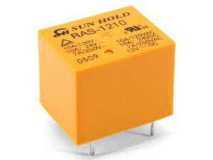
Listing Hardware…
1.Arduino Uno
2.Soil Moisture
Sensor
3.LDR Sensor
4.DHT Sensor
5.Ethernet Shield
6.Servo Motor
7.Water Pump
8.Relay and LED

Slide 10
What is Arduino ?
- “The Arduino of today is the ball bearing of the 1930s”

Slide 11
Arduino
Arduino is an open-source platform used for building electronics projects
Arduino consists of both a physical programmable circuit board (often referred to as a microcontroller) and a piece of software or IDE
The Arduino hardware and software was designed for artists, designers, hobbyists, hackers, newbies, and anyone interested in creating interactive objects or environments
Arduino can interact with buttons, LEDs, motors, speakers, GPS units, cameras, the internet, and even your smart-phone or your TV
It contains an AT-Mega328 microcontroller

Slide 12
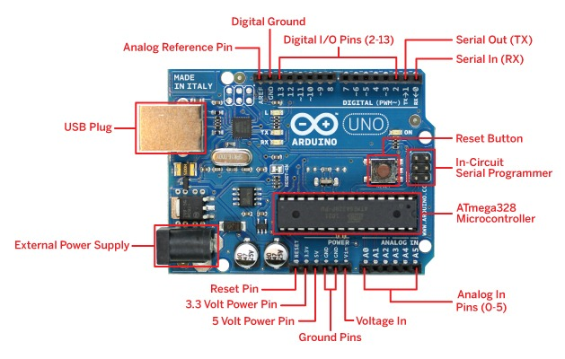
Arduino

Slide 13
Why Arduino?
Inexpensive
Cross-platform
Simple, clear programming environment
Open source and extensible software
Open source and extensible hardware

Slide 14
Sensors

Slide 15
Listing all of ‘em
Soil moisture sensors measure the water content in soil
It can be determined by the resistance between the two probes
Value from 0 - 1023
LDR is a light controlled variable resistor
The resistance of a photoresistor decreases with increasing incident light intensity
Value from 0 - 1023
DHT11 is a basic temperature and Humidity Sensor
Good for 20-80% humidity readings with 5% accuracy
Good for 0-50°C temperature readings ±2°C accuracy

Slide 16
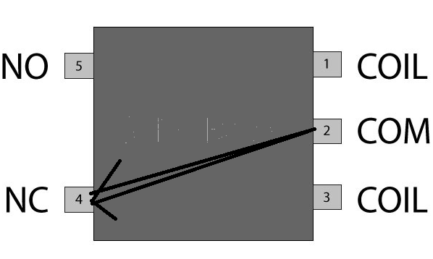
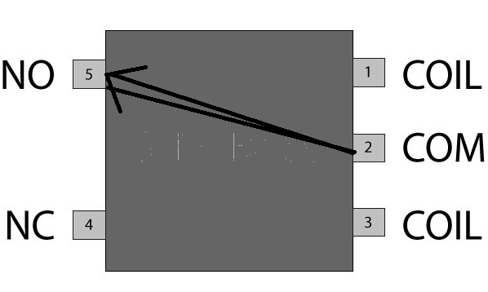
Rest of ‘em…
Operating voltage 5V (supplied from the Arduino Board)
Ethernet Controller: W5100 with internal 16K buffer
Connection speed: 10/100Mb
A relay is an electrically operated switch
Initially Common port of relay is connected with Normally Open (NO) of Relay
When trigger is pulsed CO of relay is then connected to NC Port

Slide 17
Demo

Slide 18

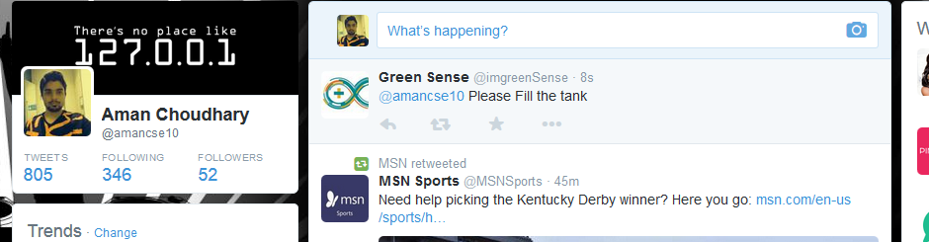
Twitter Screenshot

Slide 19
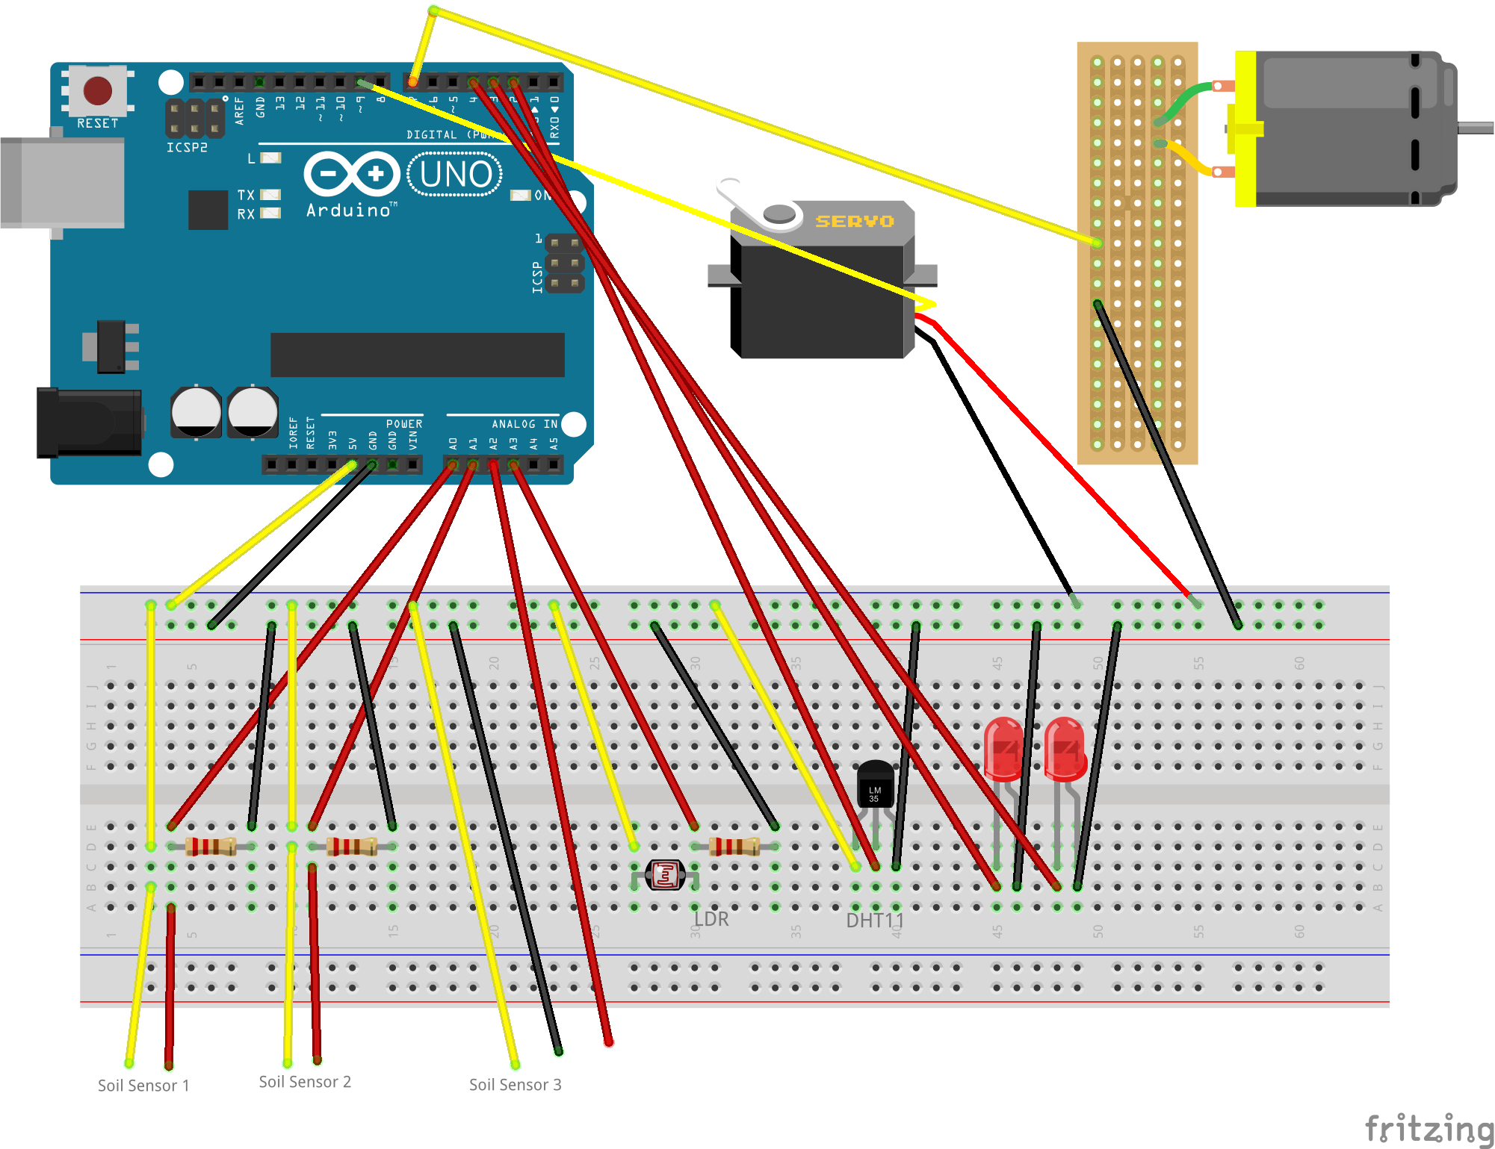
Circuit Setup…

Slide 20
Future Scope

Slide 21
Future Aspects…
To Make our System more intelligent
Controlling the System from Portable devices
Implementing IoT

Slide 22
Thank You!!!
- Happy Gardening

